Slide 1
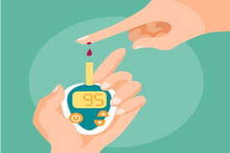
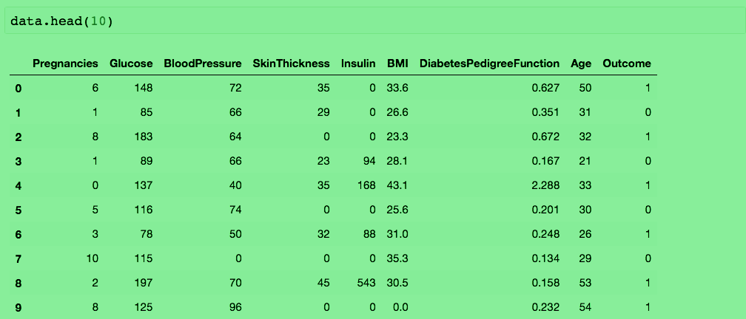

Data Mining Project
DIABETES DETECTION

Slide 2

Presenting by -
Abhishek Rajput
Ankit Kumar
Ayush Singh
Abhishek Bilung

Slide 3


Problem Statement
To study a medical report dataset and build a Classification model that predicts whether a patient will have an onset of diabetes or not based on factors cause diabetes.

Slide 4

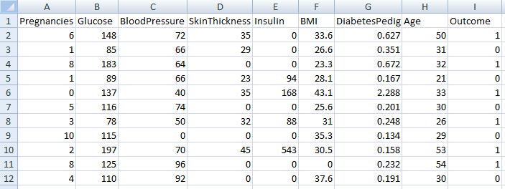

Target
KNN Algorithm
Patient has
Patient has not
Using KNN Classifier , Classifying a patient will have a diabetes or not with Accuracy.

Slide 5

List for Presentation -
Introduction to Diabetes
What is Diabetes?
What factors cause diabetes?
Analyzing and Preprocessing
Dataset Description
Data Handling
Data Normalization
Model Building
Data Slicing
Building a KNN Classifier Model
Model Optimization
Conclusion

Slide 6
Introduction to Diabetes

Slide 7
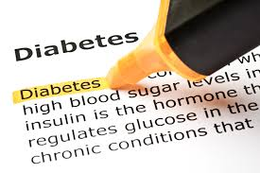
WHAT IS DIABETES?
Diabetes is a disease that occurs when your blood glucose, also called blood sugar, is too high.

Slide 8
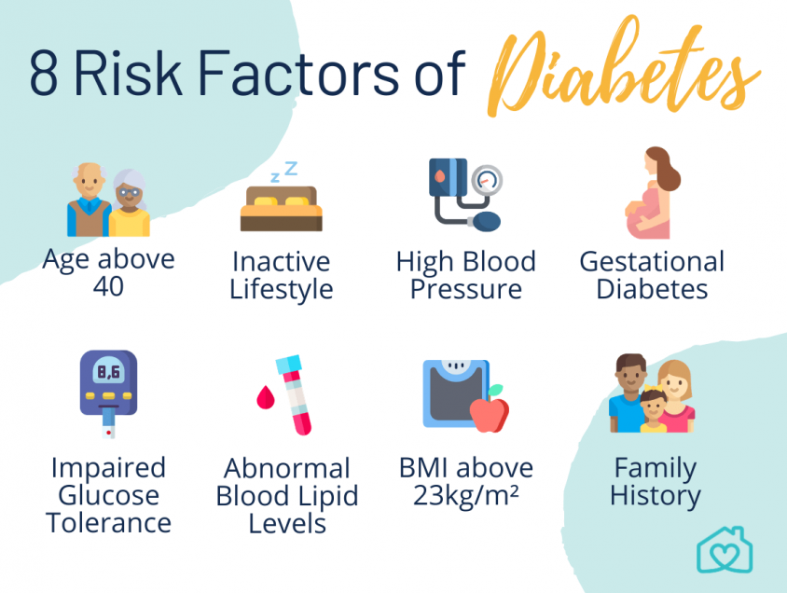
What factors cause diabetes?

Slide 9
Analyzing and Preprocessing

Slide 10
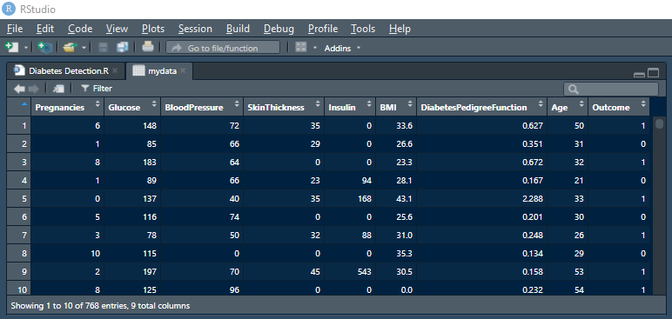
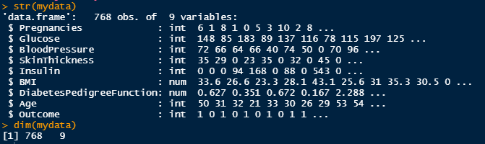


Data Description -

Slide 11
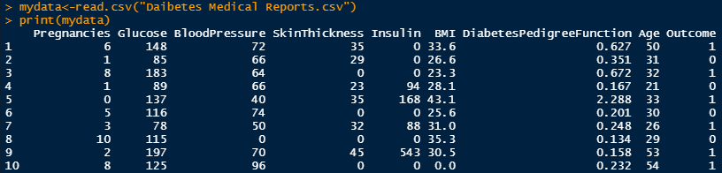
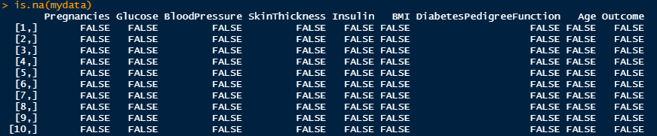
Checking missing values -
Handling missing values -
Importing dataset -
#It seems that data has no null entry. However missing value can be encoded in number of different ways.
#skin_thickness equal to zero, glucose equal to zero. Here zero, for all intent and purpose, is a missing value.

Slide 12
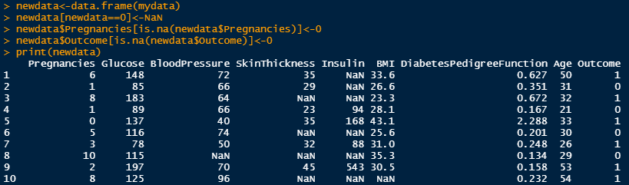
Creating newdata with replacing 0 with NaN -
#Except attributes such as Pregnancies and Outcome because it can be zero.

Slide 13
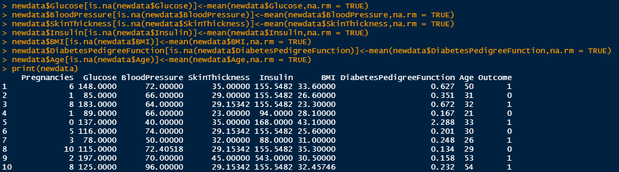
#Targeting the Attributes column, mainly Skinthicknes and Insulin.
Filling the NaN values with Mean value -

Slide 14
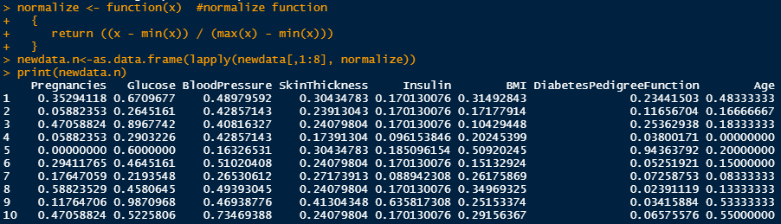
Data Normalization -
# Normalizing only Glucose and Insulin attributes because of having large values , to normalize into finite range.

Slide 15
Model Building

Slide 16
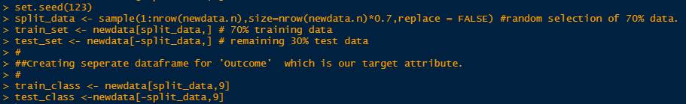
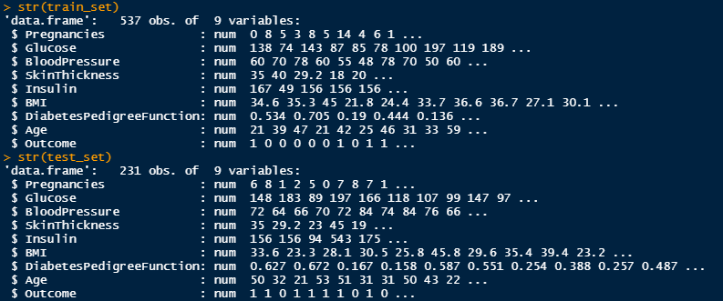


Data Slicing -

Slide 17

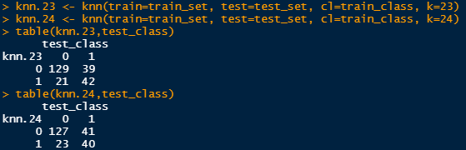
So, we have 537 observations in our training data set. The square root of 537 is around 23.17.
Building a KNN Classifier Model -
1.Initializing K value -
One of the ways to find the optimal K value is to calculate the square root of the total number of observations in the data set.
2.Creating Model -
we’ll create two models. One with ‘K’ value as 23 and the other model with a ‘K’ value as 24.

Slide 18
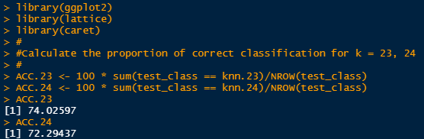
3.Model Evaluation -
After building the model, it is time to calculate the accuracy of the created models:
At K= 23 , Accuracy is high. so, the optimal k value is 23.

Slide 19
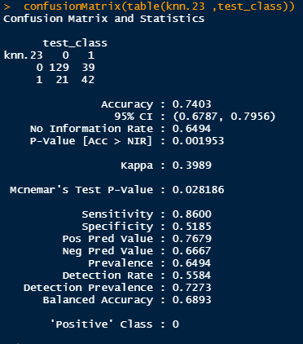
The confusion matrix to calculate the accuracy of the KNN model with K value set to 23:
So, from the output, we can see that our model predicts the outcome with an accuracy of 74.03% which is good.

Slide 20
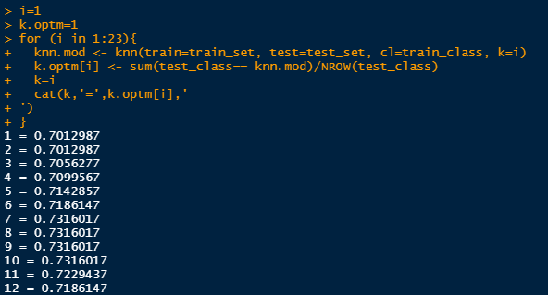
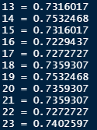
Model Optimization
In order to improve the accuracy of the model, you can use n number of techniques such as maximum percentage accuracy graph.
Here , it is a loop that calculates the accuracy of the KNN model for ‘K’ values ranging from 1 to 28

Slide 21
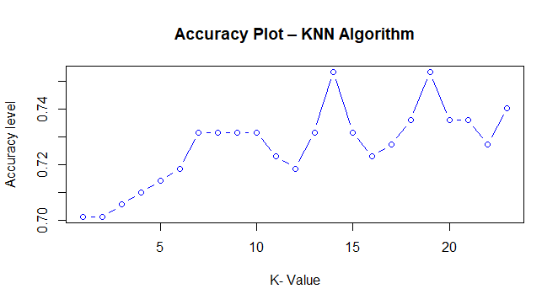
Graph Representation
From the output or you can see that for K = 14 and K=19, we achieve the maximum accuracy, i.e. 75.32%.

